Slide 1


Iterators and Comparators
SoftUni Team
Technical Trainers
Software University
http://softuni.bg

Slide 2
Table of Contents
Iterators
IEnumerable<T> interface
yield return
params
Comparators
IComparable<T> interface
IComparer<T> interface

Slide 3
Questions
sli.do #fund-csharp

Slide 4
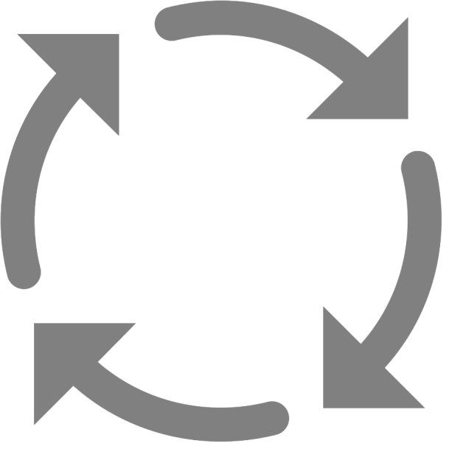
Iterators
IEnumerable<T> and IEnumerator<T>

Slide 5
IEnumerable<T>
Root interface of .NET, enables simple iteration over a collection
Contains a single method GetEnumerator(), which returns an IEnumerator<T>
A class that implements the IEnumerable<T> can be used in a foreach loop traversal

Slide 6
IEnumerable<T> Example
public interface IEnumerable<T> : IEnumerable
{
IEnumerator<T> GetEnumerator();
}
// Non-generic version // (compatible with the legacy .NET 1.1)
public interface IEnumerable
{
IEnumerator GetEnumerator();
}

Slide 7
IEnumerator<T>
Provides the sequential, forward-only iteration over a collection of any type
Methods:
MoveNext() – advances the enumerator to the next element of the collection.
Reset() – sets the enumerator to its initial position
Properties
Current – returns the element in the collection at the current position of the enumerator

Slide 8
IEnumerator<T> - Example
public interface IEnumerator<T> : IEnumerator
{
bool MoveNext();
void Reset();
T Current { get; }
}
public interface IEnumerator
{
bool MoveNext();
void Reset();
object Current { get; }
}

Slide 9
Yield Return
Indicates that the member in which it appears is an iterator
Simplifies the IEnumerator<T> implementations
Returns one element upon each loop cycle
private readonly List<Book> books;
public IEnumerator<Book> GetEnumerator()
{
for (int i = 0; i < this.books.Count; i++)
yield return this.books[i];
}

Slide 10
Params
Takes a variable number of arguments
Only one params keyword is allowed in a method declaration
Should always be last
PrintNames("Pesho", "Stamat", "Jivko", "Stavri");
public static void PrintNames(params string[] names)
{
foreach(var name in names)
Console.WriteLine(name);
}

Slide 11
Problem: Library Iterator
Create a class Library, which should store a collection of books and implement the IEnumerable<Book> interface
Book
<<IEnumarable<Book>>>
Library
+ Title: string
+ Year: int
+ Authors: List<string>
- books: List<Book>
Check your solution here: https://judge.softuni.bg/Contests/707/Iterators-and-Comparators-Lab

Slide 12

Problem: Library Iterator (2)
Inside the Library class create nested class LibraryIterator, which implements IEnumerator<Book>
<<IEnumerator<Book>>>
LibraryIterator
-currentIndex: int
-books: List<Book>
+ Current: Book
+Reset(): void
+MoveNext(): bool
+Dispose(): void
Check your solution here: https://judge.softuni.bg/Contests/707/Iterators-and-Comparators-Lab

Slide 13
Solution: Library Iterator
public class Book
{
public Book(string title, int year, params string[] authors)
{
this.Title = title;
this.Year = year;
this.Authors = authors;
}
public string Title { get; private set; }
public int Year { get; private set; }
public IReadOnlyList<string> Authors { get; private set; }
}
Check your solution here: https://judge.softuni.bg/Contests/707/Iterators-and-Comparators-Lab

Slide 14
Solution: Library Iterator (2)
public class Library : IEnumerable<Book>
{
private List<Book> books;
public Library(params Book[] books)
{
this.books = new List<Book>(books);
}
public IEnumerator<Book> GetEnumerator()
{
return new LibraryIterator(this.books);
}
IEnumerator IEnumerable.GetEnumerator()
=> this.GetEnumerator();
}
Check your solution here: https://judge.softuni.bg/Contests/707/Iterators-and-Comparators-Lab

Slide 15
Solution: Library Iterator (3)
private class LibraryIterator : IEnumerator<Book> {
private readonly List<Book> books;
private int currentIndex;
public LibraryIterator(IEnumerable<Book> books) {
this.Reset();
this.books = new List<Book>(books);
}
public void Dispose() {}
public bool MoveNext()
=> ++this.currentIndex < this.books.Count;
public void Reset() => this.currentIndex = -1;
public Book Current => this.books[this.currentIndex];
object IEnumerator.Current => this.Current;
}
Check your solution here: https://judge.softuni.bg/Contests/707/Iterators-and-Comparators-Lab

Slide 16

Live Exercises

Slide 17

Comparators
IComparable<T> and IComparer<T>

Slide 18
IComparable<T>
Reads out as "I am Comparable"
Provides a method of comparing two objects of a particular type – CompareTo()
Sets a default sort order for the particular objects type
Affects original class

Slide 19






CompareTo(T) Method Returns
< 0
= 0
> 0
Notes:
CompareTo(T) method returns:
Number < 0 – if the passed object is bigger than this object
Number = 0 – if the passed object is equal to this object
Number > 0 – if the passed object is smaller than this object

Slide 20
IComparable<T> – Example
class Point : IComparable<Point>
{
public int X { get; set; }
public int Y { get; set; }
public int CompareTo(Point otherPoint)
{
if (this.X != otherPoint.X)
return (this.X - otherPoint.X);
if (this.Y != otherPoint.Y)
return (this.Y – otherPoint.Y);
return 0;
}
}

Slide 21
IComparer<T>
Reads out as "I'm a comparer" or "I compare"
Provides a way to customize the sort order of a collection
Defines a method that a type implements to compare two objects
Doesn’t affect original class

Slide 22

IComparer<T> - Example
class Cat
{
public string Name { get; set; }
}
class CatComparer : IComparer<Cat>
{
public int Compare(Cat x, Cat y)
{
return x.Name.CompareTo(y.Name);
}
}
IComparer<Cat> comparer = new CatComparer();
var catsByName = new SortedSet(comparer);

Slide 23
Problem: Comparable Book
Implement the IComparable<Book> interface in the existing class Book
First sort them in ascending chronological order (by year)
If two books are published in the same year, sort them alphabetically
Override the ToString() method in your Book class so it returns a string in the format:
"{title} - {year}"
Change your Library class so that it stores the books in the correct order
Check your solution here: https://judge.softuni.bg/Contests/707/Iterators-and-Comparators-Lab

Slide 24
Solution: Comparable Book
public class Book : IComparable<Book>
{
public int CompareTo(Book other)
{
int result = this.Year.CompareTo(other.Year);
if (result == 0)
{
result = this.Title.CompareTo(other.Title);
}
return result;
}
}
Check your solution here: https://judge.softuni.bg/Contests/707/Iterators-and-Comparators-Lab

Slide 25
Problem: Book Comparer
Create a class BookComparator, which should implements the IComparer<Book> interface
BookComparator must compare two books by:
Book title - alphabetical order
Year of publishing a book - from the newest to the oldest
Modify your Library class once again to implement the new sorting
Check your solution here: https://judge.softuni.bg/Contests/707/Iterators-and-Comparators-Lab

Slide 26
Solution: Book Comparer
public class BookComparator : IComparer<Book>
{
public int Compare(Book x, Book y)
{
int result = x.Title.CompareTo(y.Title);
if (result == 0)
{
result = y.Year.CompareTo(x.Year);
}
return result;
}
}
Check your solution here: https://judge.softuni.bg/Contests/707/Iterators-and-Comparators-Lab

Slide 27
Live Exercises

Slide 28

Summary
Iterators
IEnumerable<T> interface
IEnumerator<T> interface
yield return
Params
Comparators
IComparable<T> interface
IComparer<T> interface
…
…
…

Slide 29
https://softuni.bg/courses/csharp-oop-advanceda

Slide 30













SoftUni Diamond Partners

Slide 31





SoftUni Organizational Partners

Slide 32




Trainings @ Software University (SoftUni)
Software University – High-Quality Education and Employment Opportunities
softuni.bg
Software University Foundation
http://softuni.foundation/
Software University @ Facebook
facebook.com/SoftwareUniversity
Software University Forums
forum.softuni.bg

Slide 33

License
This course (slides, examples, demos, videos, homework, etc.) is licensed under the "Creative Commons Attribution-NonCommercial-ShareAlike 4.0 International" license

